Slide 1

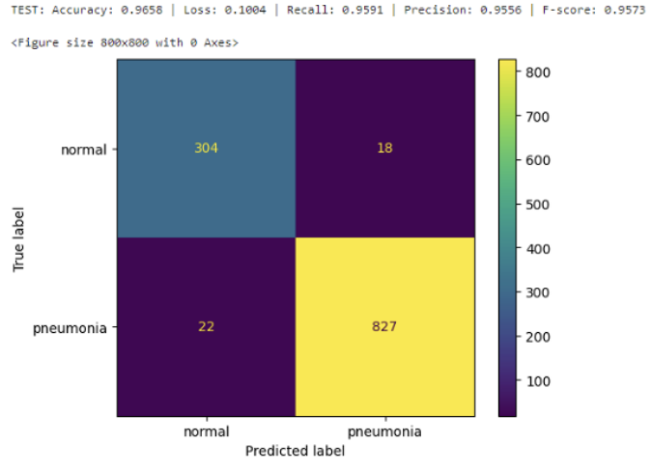
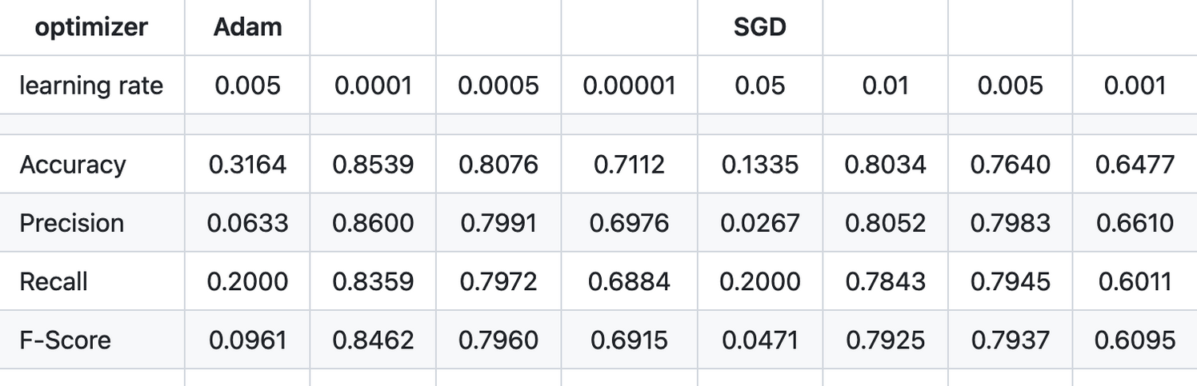
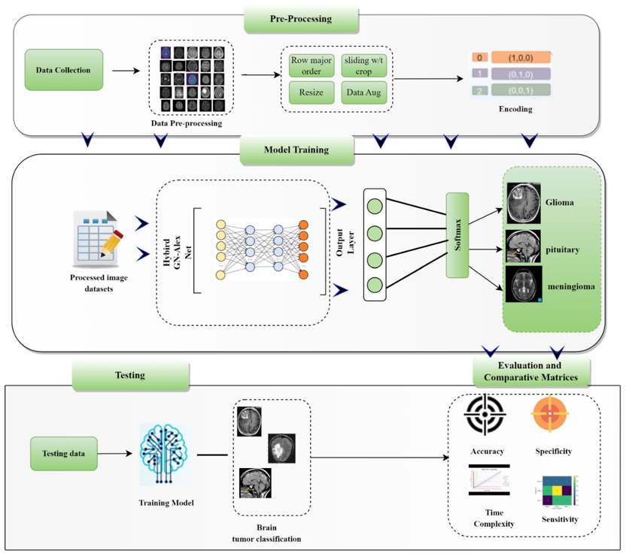
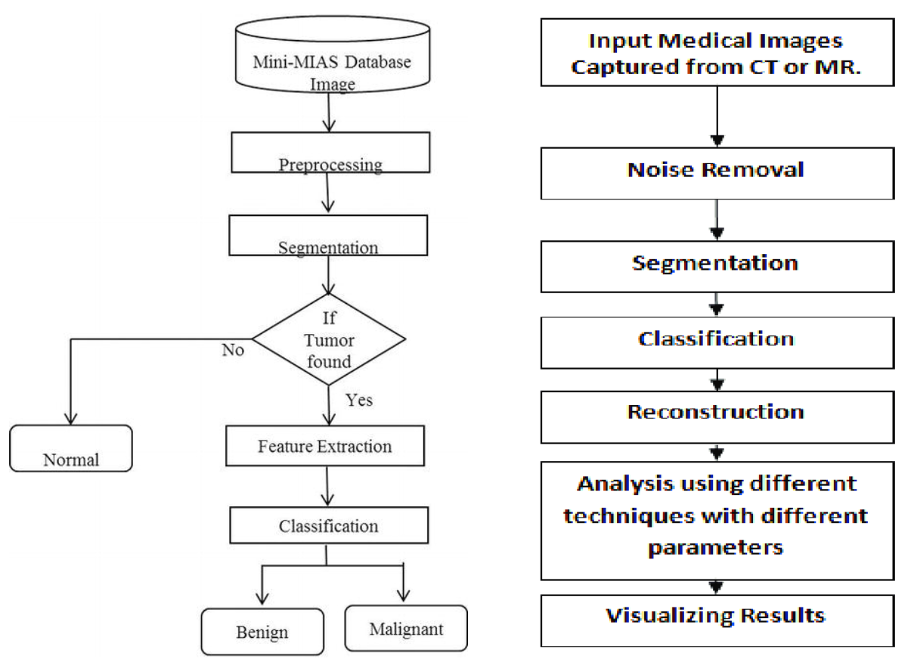
Image Recognition for Medical Diagnosis
20BCE2535 | VAISHNAV NALLADATH | Dr. Lijo V.P. | SCOPE
Introduction
Results
The research has highlighted some key gaps we need to address. Firstly, there's a problem with the diversity of datasets used in medical image studies, which leads to biases and makes it hard for AI models to work well across different groups and conditions. Also, while AI models are accurate, they can be hard to understand, raising concerns about their trustworthiness in important medical decisions. Integrating AI-powered image recognition into healthcare systems brings up compatibility issues, data sharing, and workflow disruptions. Privacy is a concern, especially with sensitive patient data and advanced AI algorithms. Lastly, even though research shows promise, we're not quite there yet in terms of using AI tools widely in real-world medical settings. More studies are needed to understand how well they work, how reliable they are, and if they're worth the investment.
After running the sample code by giving it the datasets of x-ray images, the model detects a 96.58% chance of pneumonia. This high level of accuracy in prediction underscores the model's capability to effectively discern and quantify indicators of pneumonia compared to normal x-ray images.
Motivation
The project aims to improve healthcare diagnostics by integrating advanced image recognition technologies like deep learning. This enhances decision-making, enables earlier disease detection, and reduces diagnostic times, ultimately leading to better patient outcomes and wider access to quality healthcare.
Scope of the Project
This project aims to transform healthcare by incorporating AI-driven image recognition into medical diagnostics. Its scope includes enhancing disease detection from medical imaging like X-rays and MRIs, integrating seamlessly with existing healthcare technologies, and expanding use across various medical specialties such as radiology and oncology. The project also focuses on improving treatment plans, ensuring compliance with regulatory and ethical standards, and facilitating ongoing research and development. Additionally, it encompasses educational efforts to train healthcare professionals on using this advanced technology effectively. This comprehensive approach seeks to improve accuracy in diagnostics, personalize treatment strategies, and make high-quality healthcare more accessible.
Comparison Table
Methodology
The project starts by defining the medical diagnosis task and determining image data requirements. Diverse datasets are collected and annotated accurately. Preprocessing steps include normalization, resizing, and optional augmentation for model robustness. Automatic feature extraction using CNNs involves selecting texture, shape, and color features. Principal Component Analysis (PCA) aids in feature selection. Machine learning algorithms like SVM or Random Forests are chosen for classification, trained on split datasets. Model evaluation entails metrics like accuracy and ROC curve analysis, involving medical professionals for clinical relevance. Deployment in hospitals or clinics follows, with ongoing refinement based on feedback.
Conclusion
The Project represents a significant advancement in healthcare technology, harnessing the power of AI to improve the accuracy, efficiency, and accessibility of medical diagnostics. By integrating sophisticated image recognition technologies into medical imaging devices, enhancing 3D imaging capabilities, expanding telemedicine services, and addressing ethical and privacy concerns, this project is set to transform medical diagnostics. It promises to deliver faster, more accurate diagnoses, personalized treatment plans, and greater healthcare access, particularly for underserved populations, thereby improving patient outcomes and streamlining healthcare delivery. This initiative not only showcases the potential of AI in revolutionizing healthcare but also emphasizes the importance of responsible innovation to ensure patient safety and trust.
System Architecture Diagram 1.
The diagram describes the different modules of the project. And how they interact with each other.
References
[1] Jiang, X., Hu, Z., Wang, S., & Zhang, Y. (2023). Deep Learning for Medical Image-Based Cancer Diagnosis. Cancers, 15(14), 3608. https://doi.org/10.3390/cancers15143608
[2] Li, L.-F., Wang, X., Hu, W.-J., Xiong, N. N., & Du, Y.-X. (2020). Deep Learning in Skin Disease Image Recognition: A Review. Journal of Medical Systems, Volume 8
[3] S. Budd, E. C. Robinson and B. Kainz, "A survey on active learning and human-in-the-loop deep learning for medical image analysis", Med. Image Anal., vol. 71, 2021.
[4] P. Gope, Y. Gheraibia, S. Kabir and B. Sikdar, "A secure IoT-based modern healthcare system with fault-tolerant decision-making process", IEEE J. Biomed. Health Informat., vol. 25, no. 3, pp. 862-873, Mar. 2021.
[5] W. Chen et al., "Spherical-patches extraction for deep-learning-based critical points detection in 3D neuron microscopy images", IEEE Trans. Med. Imag., vol. 40, no. 2, pp. 527-538, Feb. 2021.
[6] Rana, M., Bhushan, M. Machine learning and deep learning approach for medical image analysis: diagnosis to detection. Multimed Tools Appl 82, 26731–26769 (2023). https://doi.org/10.1007/s11042-022-14305-w
[7] 1. Z. Guo, Y. Shen, S. Wan, W. -L. Shang and K. Yu, "Hybrid Intelligence-Driven Medical Image Recognition for Remote Patient Diagnosis in Internet of Medical Things," in IEEE Journal of Biomedical and Health Informatics, vol. 26, no. 12, pp. 5817-5828, Dec. 2022, doi: 10.1109/JBHI.2021.3139541.
System Architecture Diagram 2.
This diagram shows the methodology of the project.

